Slide 1

HONG KONG 2023
ASC GIA
FOR THE YOUNG

Slide 2
After Tokyo Congress in May 2017, all centers in Japan made their own plan with all their might based on the result of the Congress. At that point, no one knew that unprecedented COVID-19 pandemic would hit not only Japan but also the whole world.

Slide 3
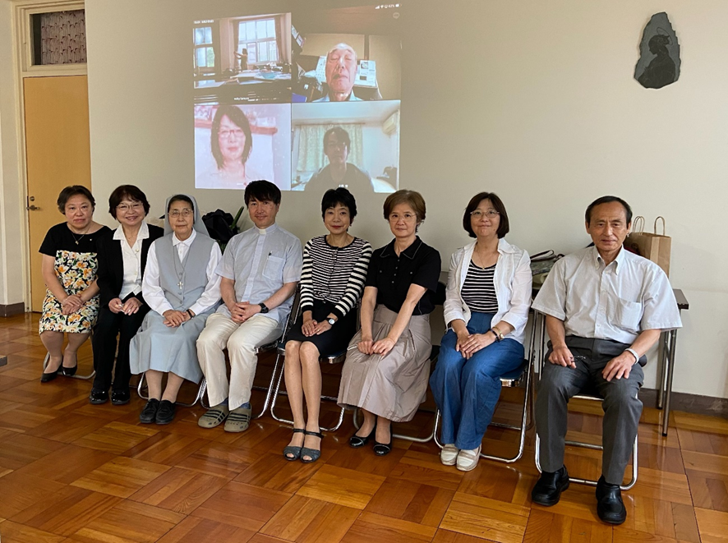
In 2020, Japan Province had an election, and new council started to work under new coordinator, Ms. Eriko Sato with new SDB delegate, Fr. Tamura.

Slide 4
Due to the COVID-19 pandemic, activities in catholic churches were unavoidably restricted, and so was those of ASC centers. Each center continued minimal activities for the young under such restrictions. Exempted contribution was donated to Don Bosco Oratorio and World Youth Day Lisbon.

Slide 5
Around that time, Vietnamese youth coming to Japan as technical intern increased steeply, and Chofu Salesian Center and Meguro Center started Japanese language class for those Vietnamese youth. Due to the COVID-19 pandemic, face-to-face class had to be changed to the on-line class.

Slide 6
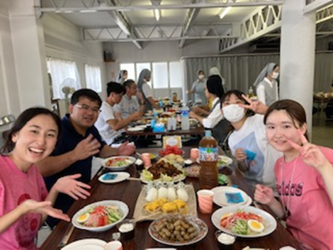
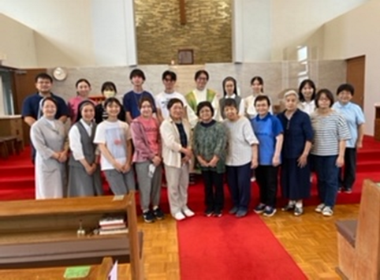
【Activities of ASC Centers in Japan】
@ Nagasaki Center
Meal service for SYM (Salesian Youth Movement) pilgrim group
“It was our joy to see their cheerful smile. They gave us energy!”
“Thank God for this special opportunity.”

Slide 7
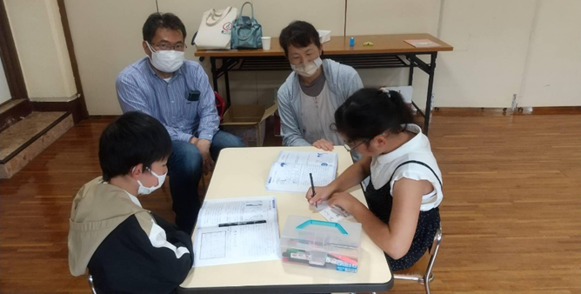
@ Miyazaki Center
Sunday School for gospel teaching, Bible study, catechism class, etc.

Slide 8
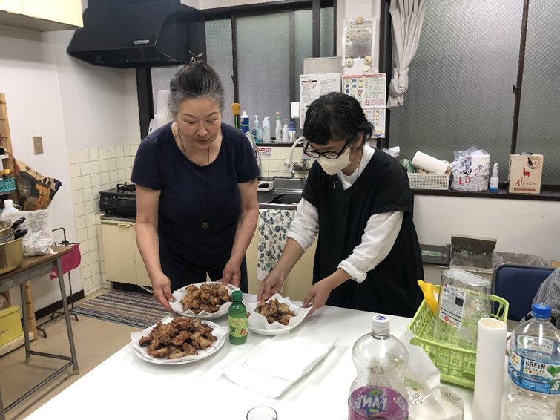
@ Chofu Salesian Center
Snack service for Vietnamese youth.

Slide 9
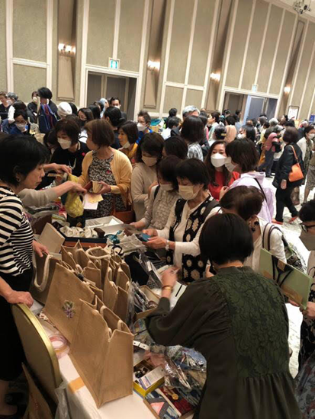
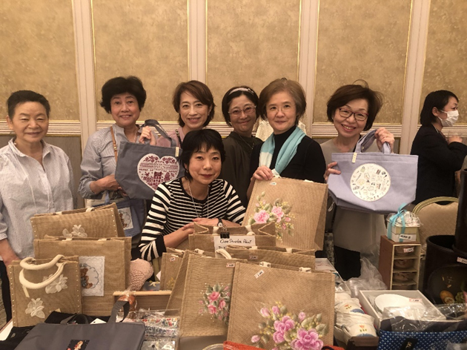
@ Meguro Center & Chofu Salesian Center
Joint fund-raising activity for DBVG (Don Bosco Volunteer Group)
At Charity Bazaar of Asia-Pacific Ladies Friendship Society at Meiji Kinenkan on May 10, 2023.

Slide 10
Though we have reached the youth around us, it is still far from what Pope Francis said, i.e., “Go out, and reach out.” Due to the COVID-19 pandemic, our activities tended to be inward and closed. Now, the pandemic seems to be ceased, and we would like to walk together with young people and work for them as Salesian.

Slide 11
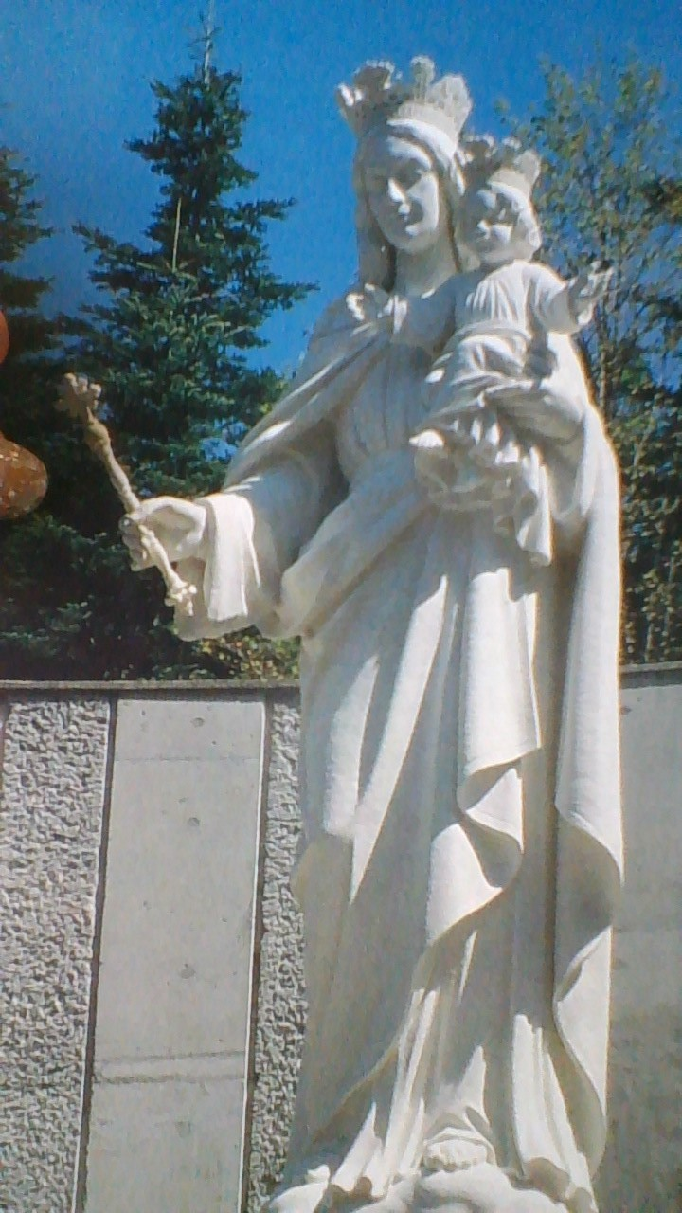
Thank you！
謝謝！
ありがとうございました！

